Slide 1
Unit ‘5’ Authentication and Public Key Infrastructure (Part 2)
Prepared by: Abhishek Dewan Cryptography Lecturer Trinity International College

Slide 2
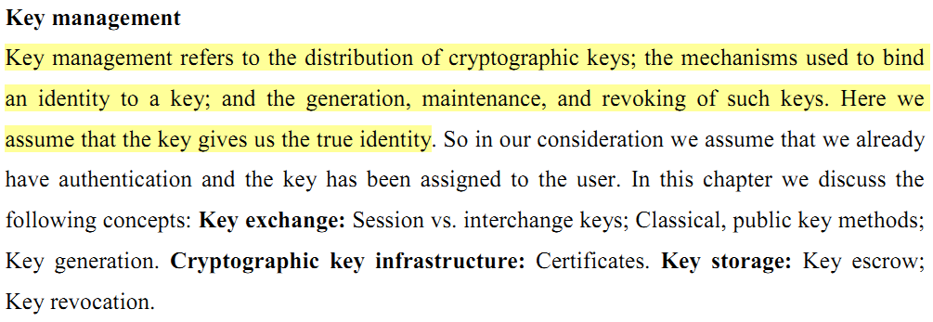
Key management

Slide 3
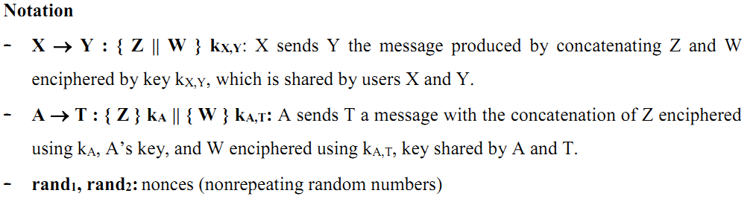
Some notations used in key communication

Slide 4
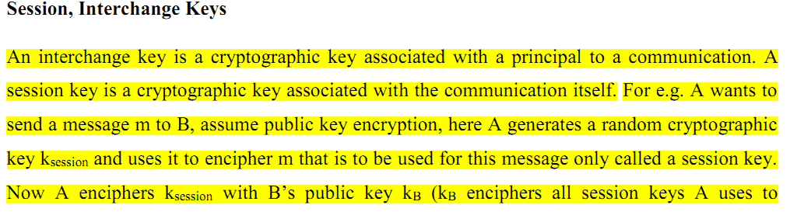
Session keys Interchange keys
Which means encrypting message m with session key k_session and k_session key with B’s public key(interchange key).

Slide 5

decreases the amount of traffic an attacker can obtain, because each session uses different keys.

Slide 6
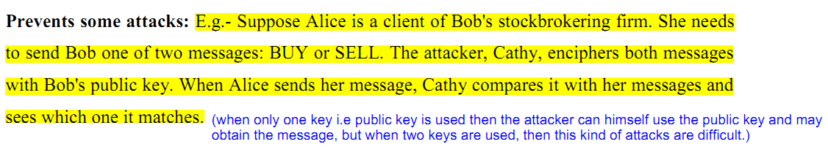
Since, the public key is publically known, the attacker may first intercept the messages and then encrypt with one user’s public key. Then he compares it with the intercepted message to know the content.

Slide 7
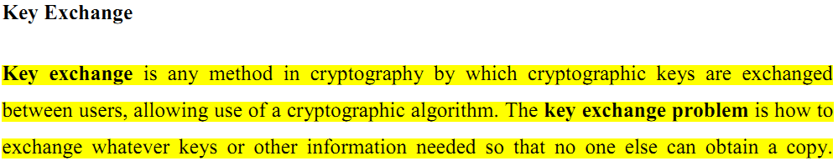
Key Exchange

Slide 8
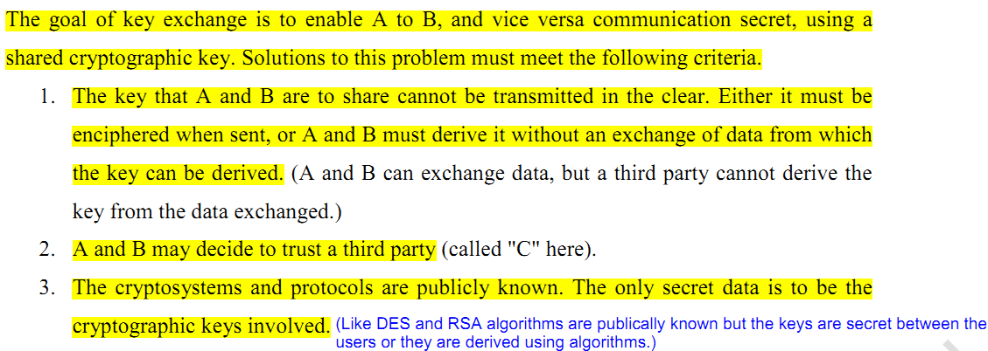
Purpose of key exchange

Slide 9
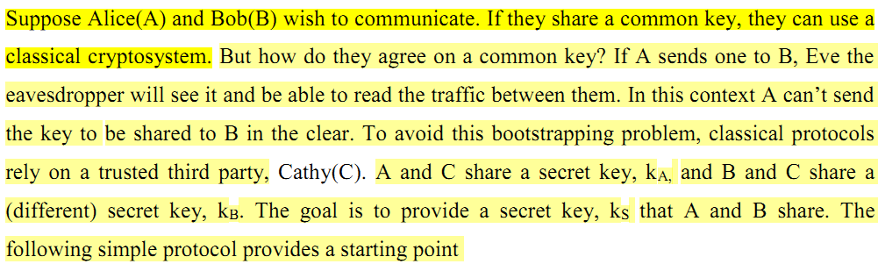
Classical Key exchange

Slide 10
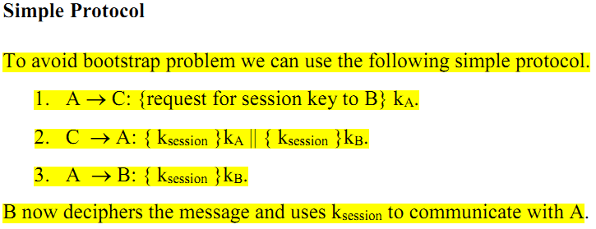
Protocol used in Classical key exchange
Here, A wants to communicate with B. So, he requests for a key with the trusted third party key generator C. C provides A the session key, k_session encrypted with key k_a shared between A and C. C also provides A the session key, k_session encrypted with key k_b shared between B and C. A then forwards the k_session key to B. B can then decrypt it with key K_b to obtain the same key as A and start the communication using that key.

Slide 11
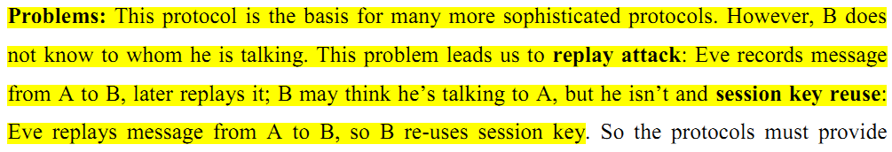
Problems with classical key exchange

Slide 12
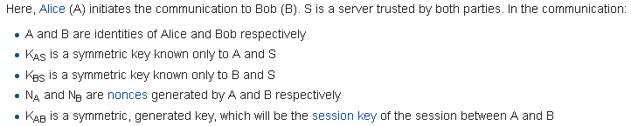
Needham-Schroeder Protocol
Under Needham-Schroeder Protocol, we have: 1) Needham-Schroeder protocol with symmetric key
2) Needham-Schroeder protocol with assymetric key

Slide 13
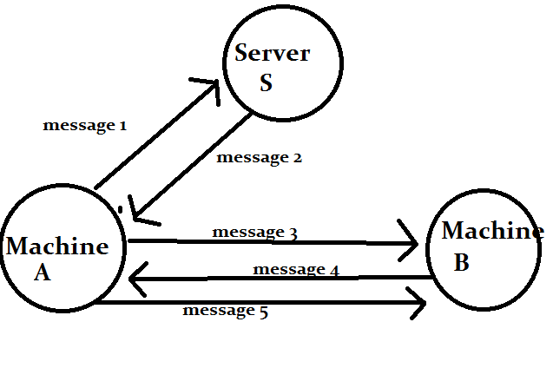
Needham-Schroeder protocol with symmetric key

Slide 14
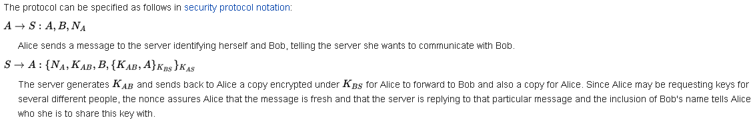
Protocol notation

Slide 15
*Nonce: In cryptography, a nonce is an arbitrary number that may only be used once. It is often a random or pseudo-random number issued in an authentication protocol to ensure that old communications cannot be reused in replay attacks.

Slide 16
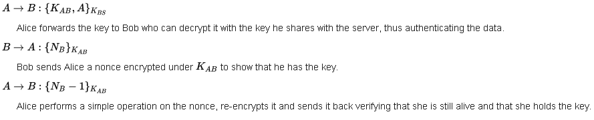

Slide 17
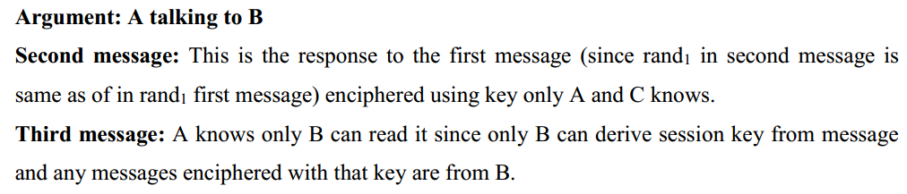

Slide 18
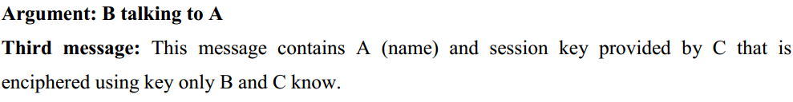

Slide 19
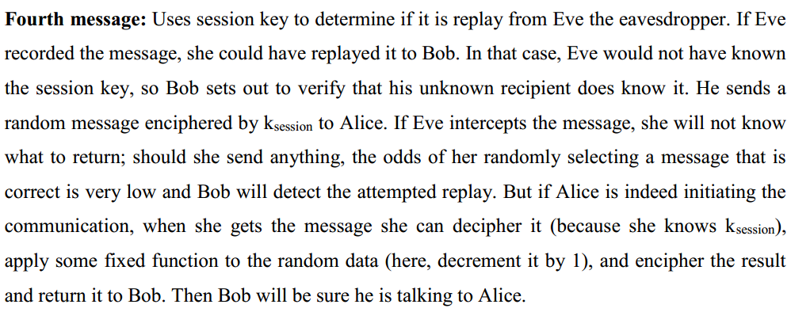

Slide 20
Attacks on the protocol

Slide 21
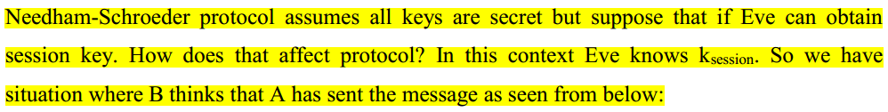
Fixing the attack: Denning-Sacco Modification

Slide 22
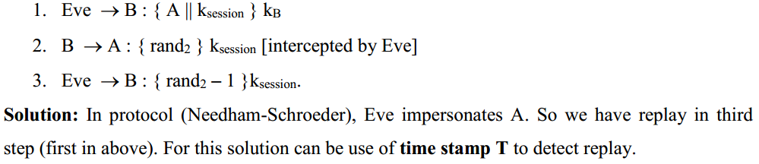

Slide 23
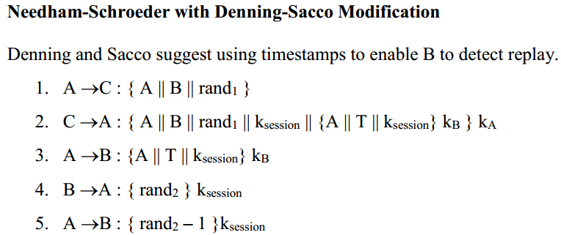
Needham-Schroeder with Denning-Sacco Modification

Slide 24
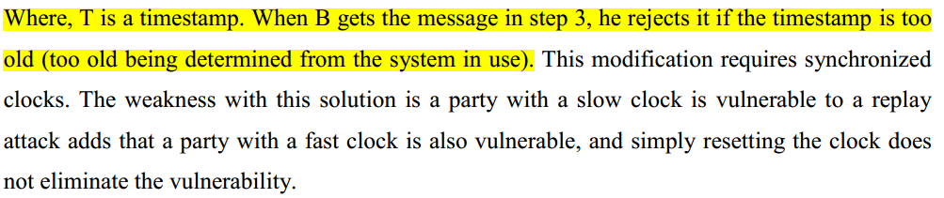

Slide 25
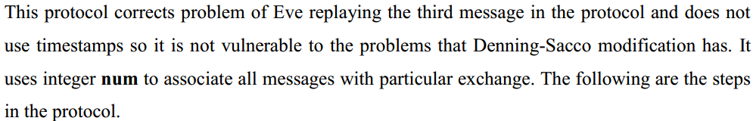
Otway-Rees Protocol

Slide 26
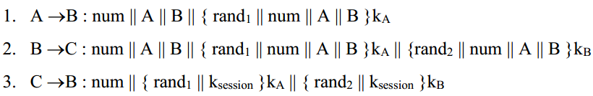


Slide 27
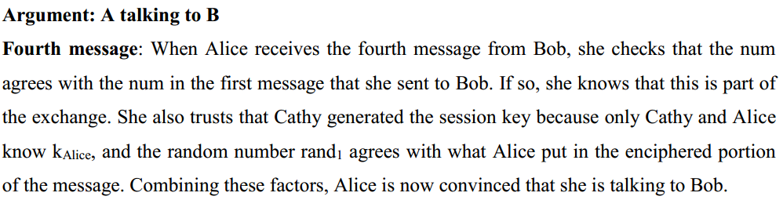

Slide 28
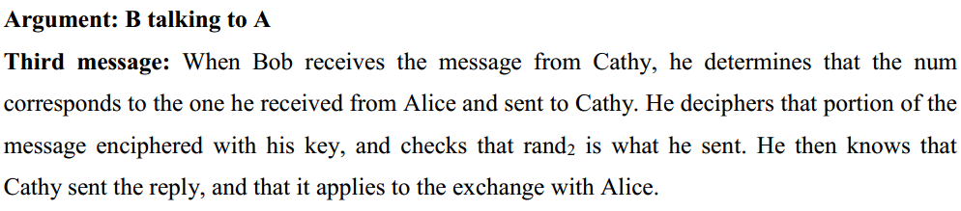

Slide 29
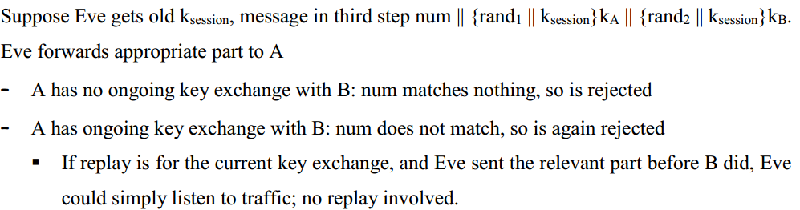

Slide 30
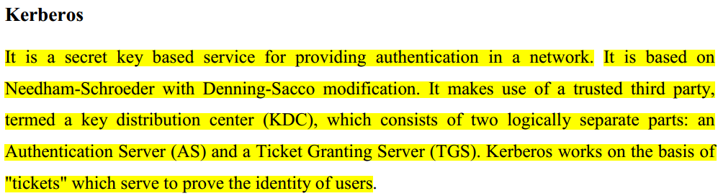
Kerberos

Slide 31
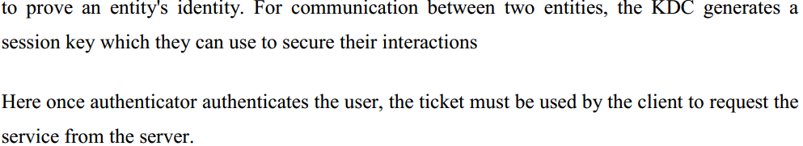

Slide 32
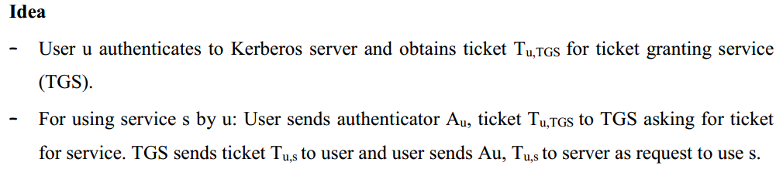
How Kerberos works

Slide 33
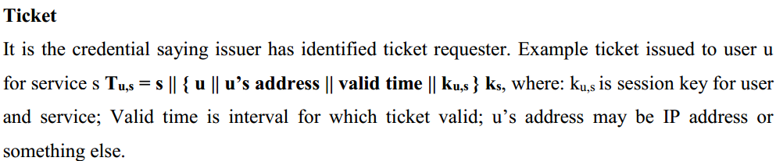
Kerberos works on the basis of Ticket.

Slide 34
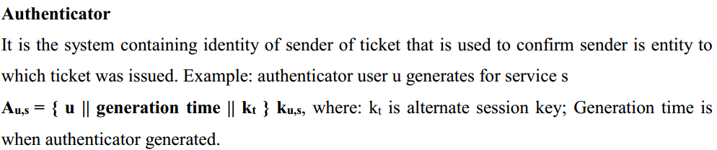

Slide 35
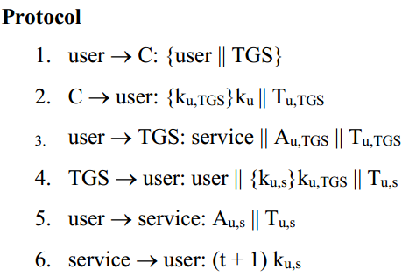
Kerberos Protocol

Slide 36
Key Distribution Center
User (Alice)
Server (Bob)
AS
TGS
1) Request ticket for TGS
2)Alice-TGS session key and ticket for TGS
3)Request ticket for Bob
4)Alice-Bob session key & ticket for Bob
5)Request access
6)Grant access

Slide 37
Step 1:
User asks Authenticating Server the ticket for Ticket Granting Server. For this, the user sends his identity and request for ticket to TGS.

Slide 38
Step 2:
The Authentication Server identifies and authenticates the user that he is valid. Then, AS provides the user the session-key K_u,TGS between user and TGS encrypting it with user’s key k_u. The AS also provides the Ticket T_u,TGS to the user for communicating with TGS.

Slide 39
Step 3:
After the user gets ticket to TGS, he communicates with TGS. He provides his identification and authentication A_u,TGS and also the ticket T_u,TGS asking for the ticket to communicate with Server or the other user.

Slide 40
Step 4:
The TGS then provides the user, the session_key between user and the server(Bob) encrypting it with session_key between user and TGS K_u,TGS. The TGS also provides the user the ticket T_u,s to communicate with server.

Slide 41
Step 5:
After the user gets the ticket to communicate with the server, he then authenticates himself with A_u,s. He then also provides the ticket T_u,s requesting for the service or permission to communicate.

Slide 42
Step 6:
The server then provides the service to the user or communicates with the user.
It may also include confirmation from the server.

Slide 43
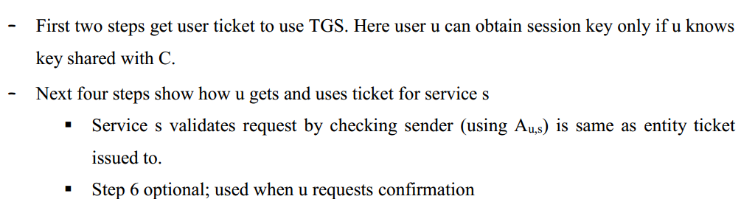
Analysis of Kerberos Protocol

Slide 44
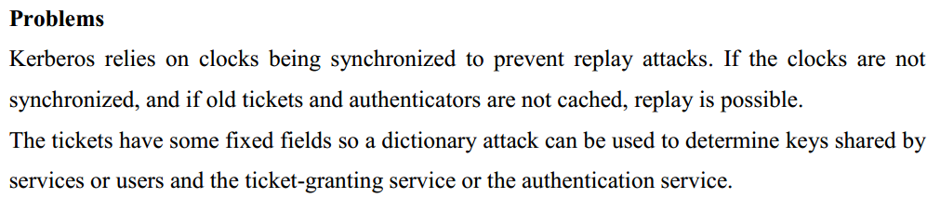

Slide 45
*Note: Refer note and book for topics covered in this unit.
End of Unit ‘5’ part 2

